Slide 1
Terrain tools
Armandas Abramavičius – 20258497

Slide 2
Tutorial Contents
We will learn:
How different brushes are used (Height Brushes);
Hydraulic / Thermal erosion and smoothing;
Brush masks, noise, falloff, and repeatable terrain edits;
Creating a more natural terrain;

Slide 3
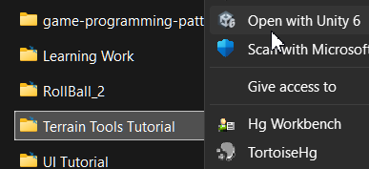
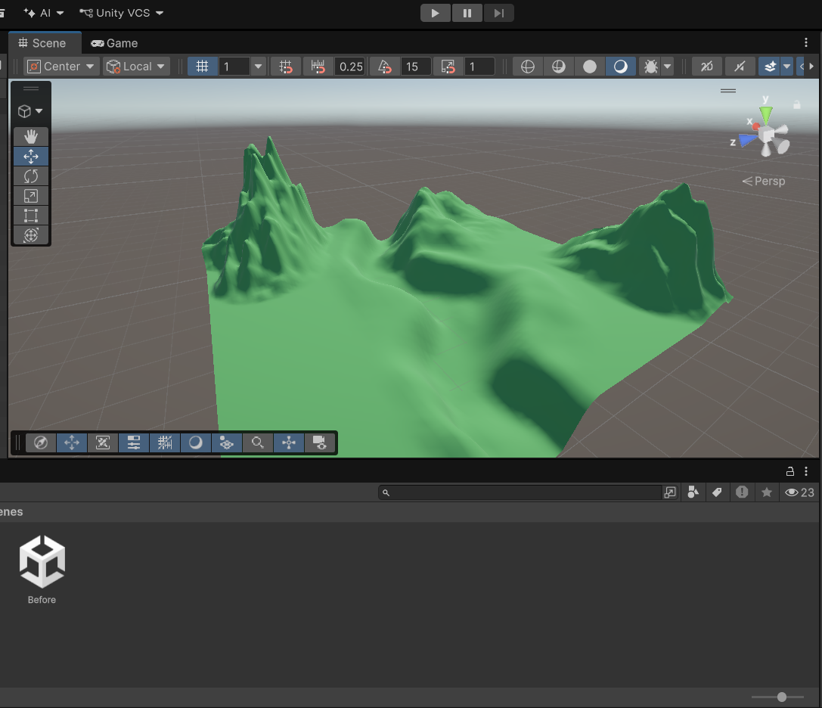
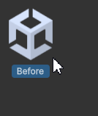
Step 1: open file
Open the project;
Open “Before” scene in Scenes folder;

Slide 4
Terrain Setup
The terrain you see is 1000x1000x600 resolution (1000 length, 1000 width, 600 height) and heightmap resolution is the default 512x512 and I simply added a green material to simulate grass

Slide 5
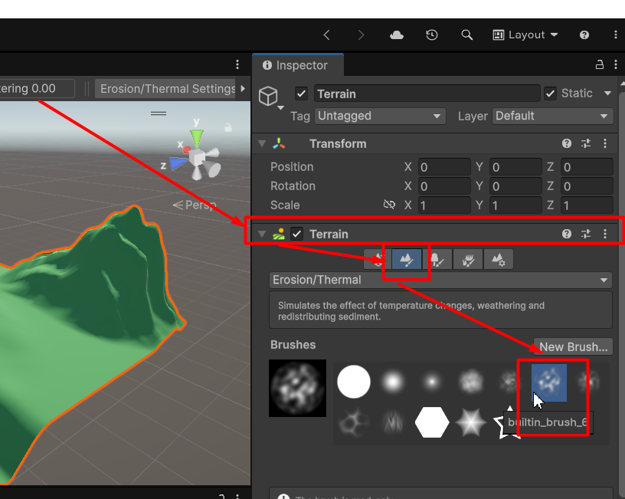
Step 2: INspect
To make the current terrain more realistic, first thing we’re gonna do is polish how mountains look;
To do that:
Click on the Terrain object (either in Hierarchy or in Scene)
Under [Terrain] component, select the 2nd icon “Paint Terrain”

Slide 6
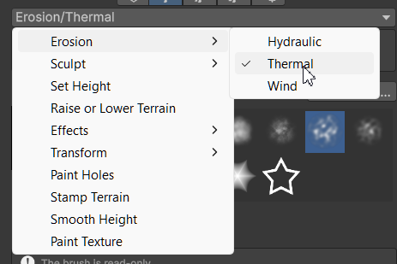
Step 3: select thermal
Now select the Thermal Erosion setting for the brush;
To do so:
Click on the dropdown menu located above brushes;
Erosion -> Thermal;

Slide 7
Hydraulic & Thermal erosion
Difference between [Hydraulic] and [Thermal] erosion tools:
Hydraulic erosion tool allows you to realistically shape the terrain in a way that simulates moving water that carves channels, moves away soil or carries over sediments;
Thermal erosion tool flattens steep slopes by sliding the shape down; it softens overly steep hills;
Put in simple terms – hydraulic is for water erosion; thermal is for mountains or steep terrain;

Slide 8
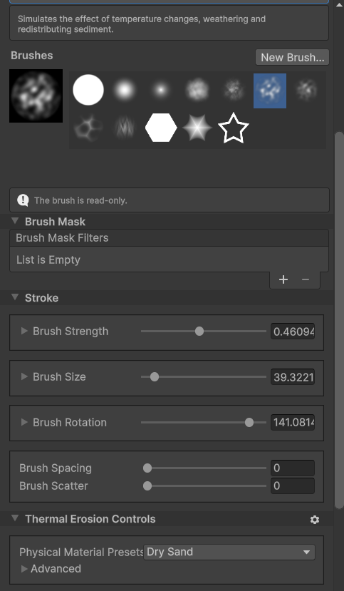
Step 4: adjust brush
These are the brush stroke settings I am using for thermal erosion;
They don’t have to be entirely accurate, just rough estimates;

Slide 9
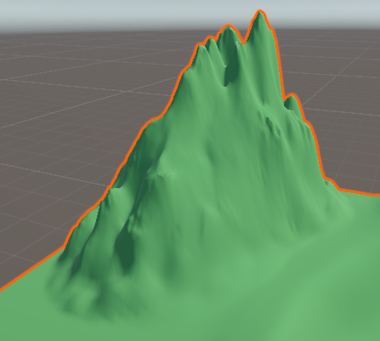
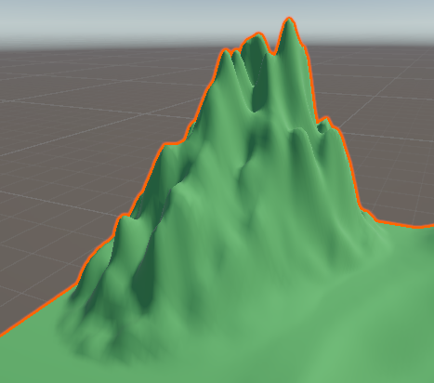
Step 5: polish all steeps
Now with the brush and its settings adjusted you will want to lightly hold / tap on the steepest parts of all mountains in the map to make them look more realistic with the thermal erosion tool
Before
After

Slide 10
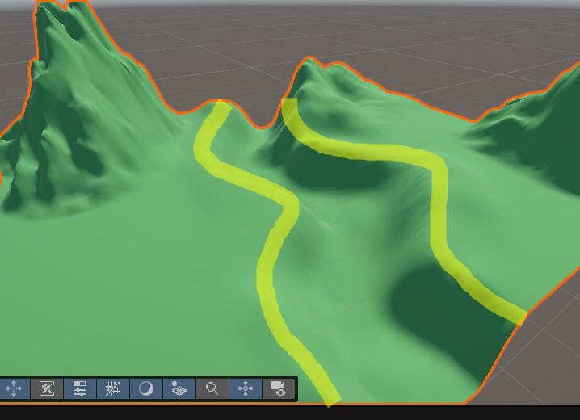
bonus
I also used Thermal erosion tool on the slope of the river to add ridges;
Also do not be scared playing with brush strength & size settings;

Slide 11
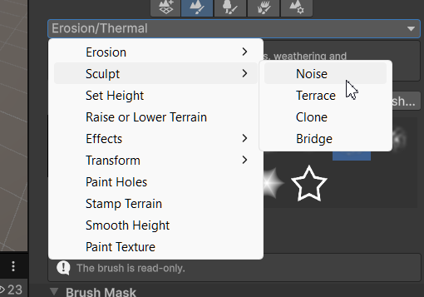
Step 6: Noise
After you’re done polishing all the mountains, we move on to [Noise];
Go in to the dropdown menu;
Select Sculpt -> Noise;

Slide 12
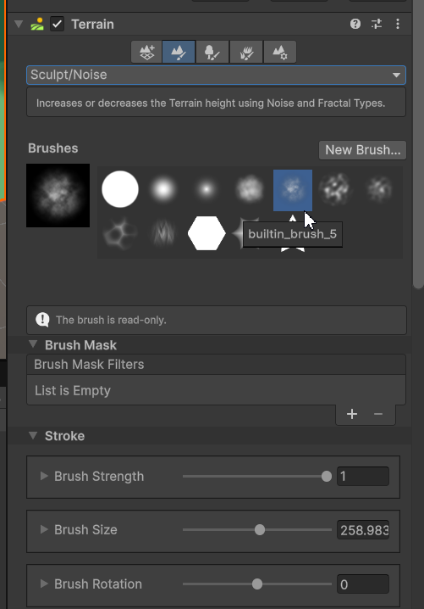
Step 6: Noise
For this ill use the 5th brush and these settings;
But the settings used are not strict, you can play around with them as you see fit for your terrain;

Slide 13
Noise
Noise can be used to give more “roughness” to the surface which can be a nice detail when making realistic terrain;
You can also use Noise in the brush masks as it is similar in functionality;

Slide 14
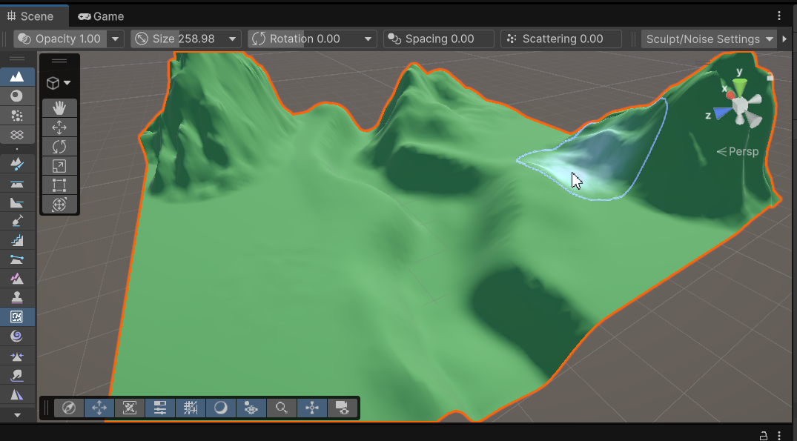
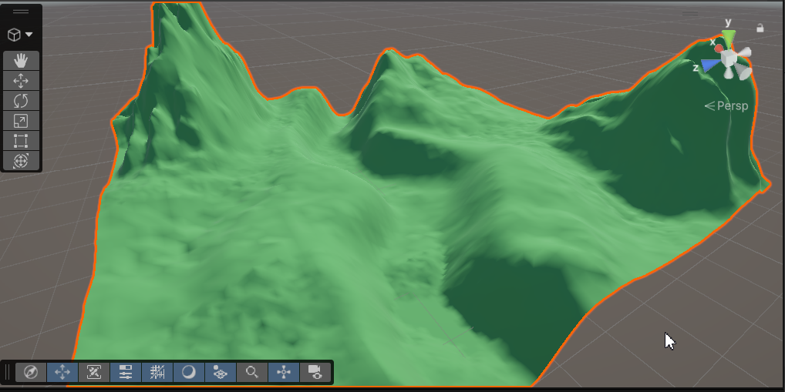
Step 7: roughen flat surfaces
Now we can make our terrain look even more realistic by using noise on all the flat surfaces in our map;
Before
After

Slide 15
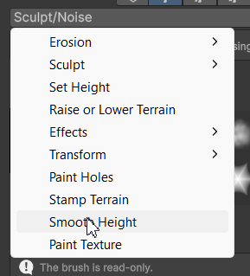
Step 8: Smoothing
If you apply too much noise for your liking and everything looks too rough, you can use smoothing for some parts of the terrain to make It more flat;
To do so, you can select [Smooth Height] in the dropdown menu;
Use any size & strength for the brush settings that is fit to your needs

Slide 16
Brush masks
In your terrain sculpting process you can also use brush masks that can help you on the way; For example, even if you set the brush strength to max and its still lacking, you can use “Multiply” or “Power” brush mask to increase its effectiveness;
Some masks aren’t as useful as others, for example Negate simply acts the same as if you were to hold CTRL which removes height instead of adding it;

Slide 17
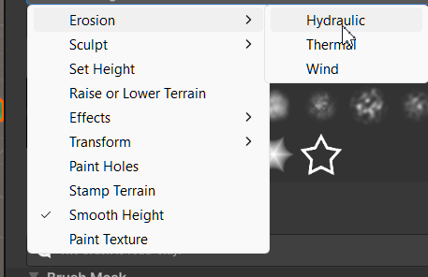
Step 9: hydraulic Erosion
Now we’re gonna focus on the river more, and for that we can use Hydraulic Erosion;
Dropdown menu -> Erosion -> Hydraulic;
If you like the details as is, you can not use
this tool, but it almost acts as smoothing;

Slide 18
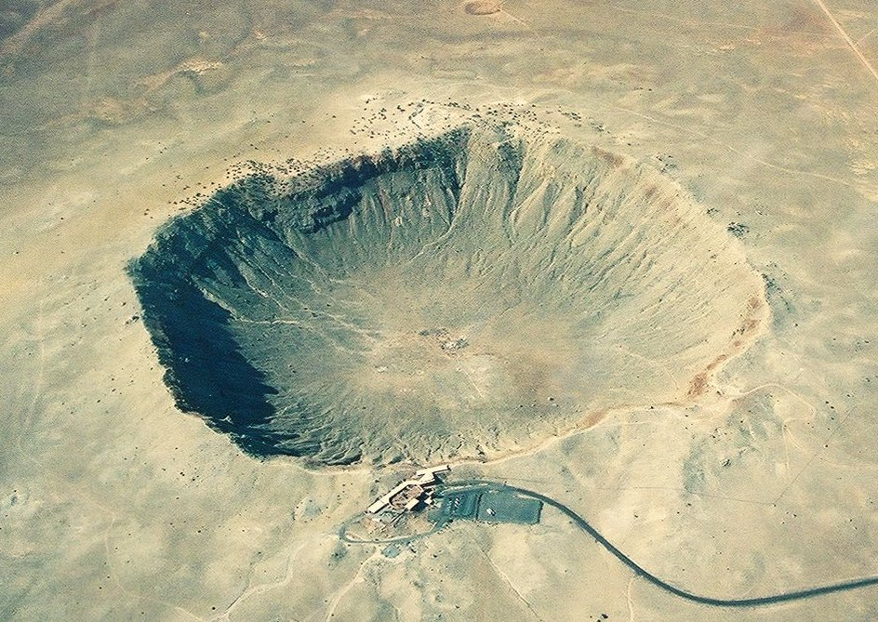
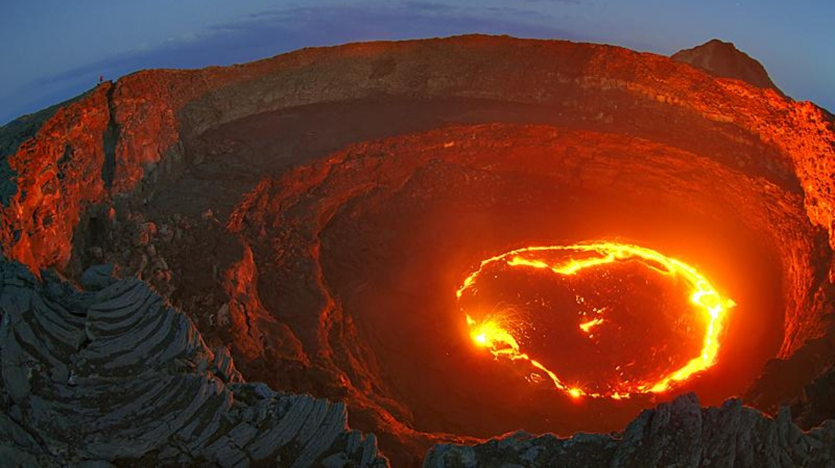
Falloff
Brush Falloff defines how the strength of a brush fades from its center to its outer edges; We are not gonna use it in this project, but I’ll provide an example on how it works;
If you wanted to make a “volcano” brush or a “moon crater” brush you can use brush falloff for that;

Slide 19
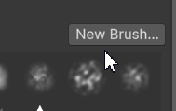
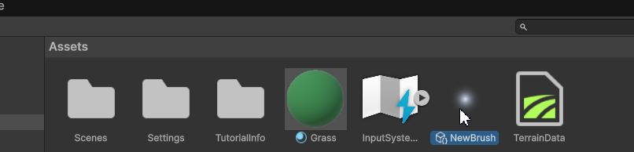
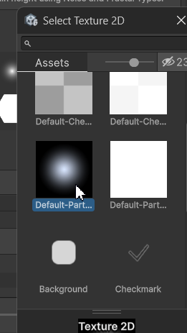
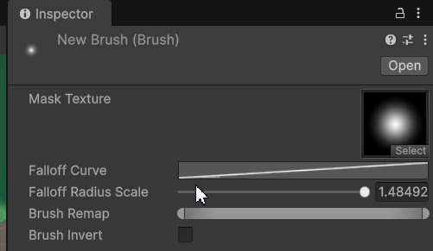
Falloff
Create a new brush
Select the default texture
Select it in the Project window
Click on [Falloff Curve]

Slide 20
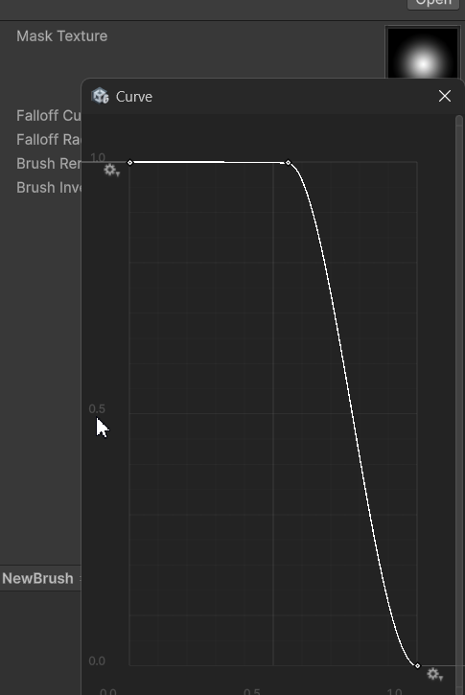
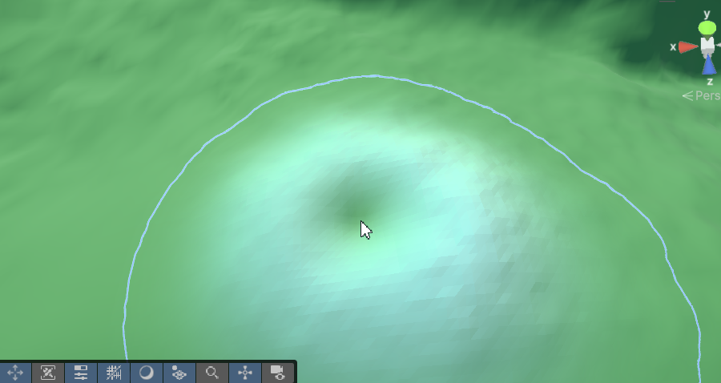
Falloff
So if you make your falloff curve like this
You can have a “crater” brush like so;

Slide 21
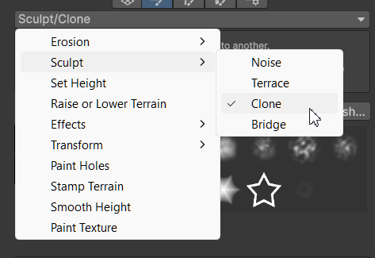
Cloning
If you want to clone similar terrain or its edits you can use clone tool;
To do that:
Dropdown menu -> Sculpt -> Clone

Slide 22
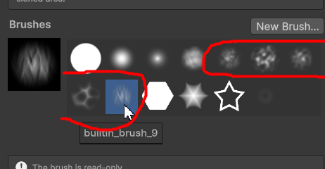
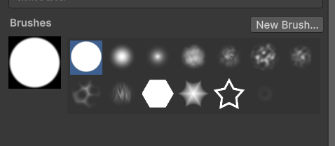
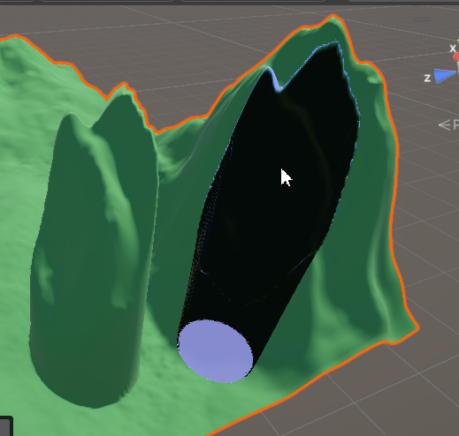
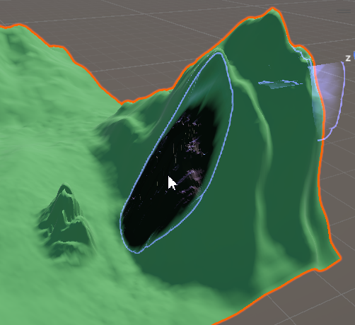
With cloning, if you want a very similar copy, use the full circle brush
But if you want more randomized results, use any brush from 5th to 9th

Slide 23
Thank you for your attention

